Slide 1
AggMapNet: enhanced and explainable low-sample omics deep learning with feature-aggregated multi-channel networks
Zihan Zhong
2024-02-19

Slide 2
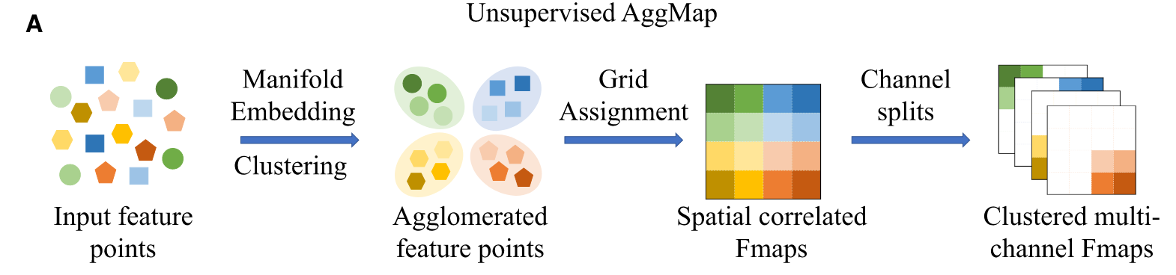
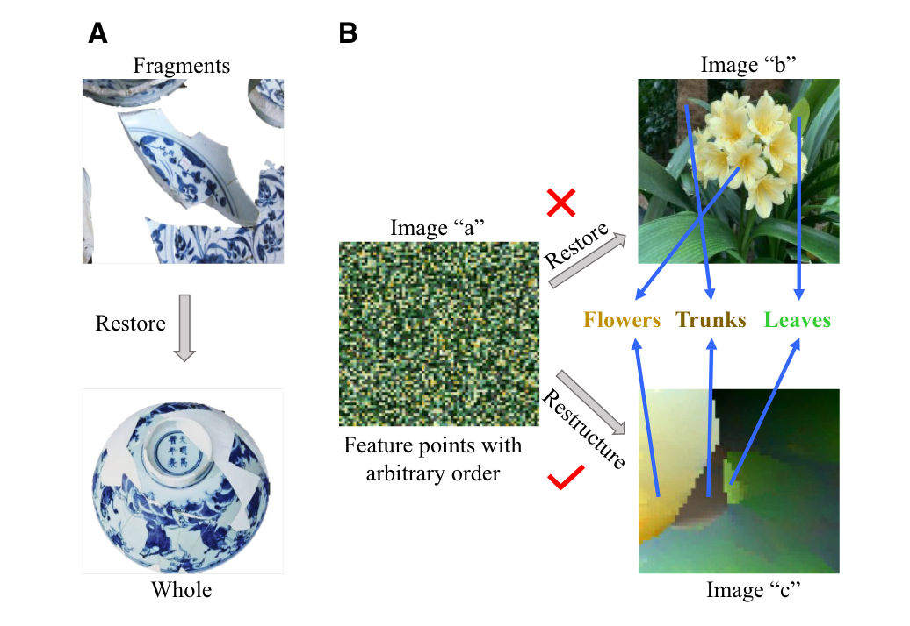
Key Concepts
BioHULM (High dimensional, Unordered feature, Low-sample size, and Multiplatform) Data
Firstly, the separation of the FPs into several groups (channels) enables feature group-specific or feature-selective learning.
Secondly, multi-channel Fmaps provide more enriched information and more distinguished patterns than single channel Fmaps.

Slide 3
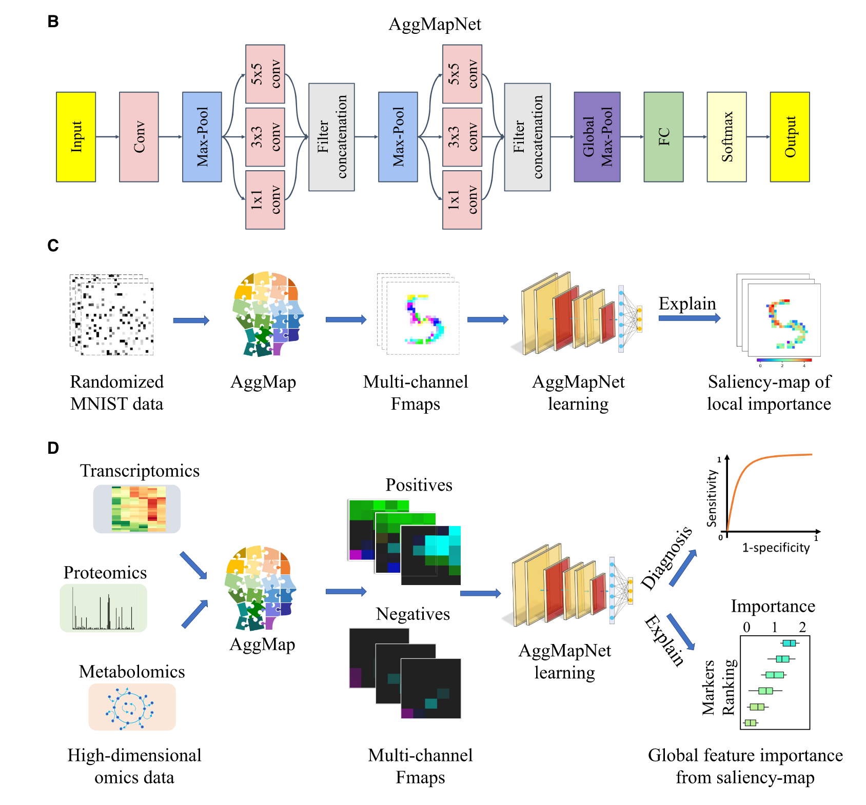
Key Concepts

Slide 4
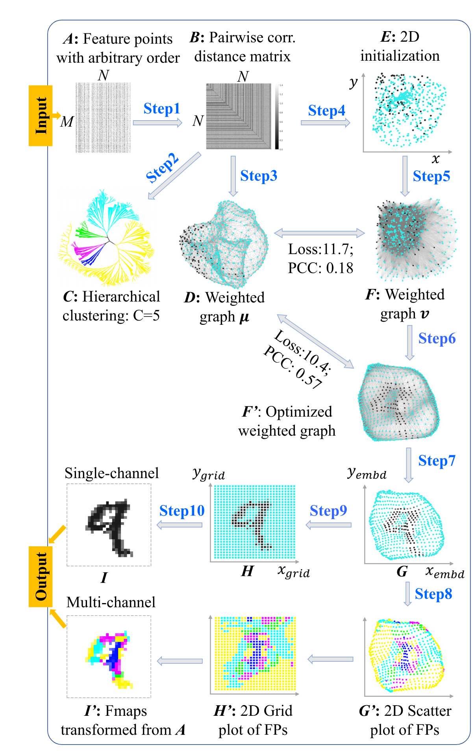
Embedding Pipeline

Slide 5
Embedding Pipeline
Step3-7: UMAP

Slide 6
Embedding Pipeline
Step3-7: UMAP

Slide 7
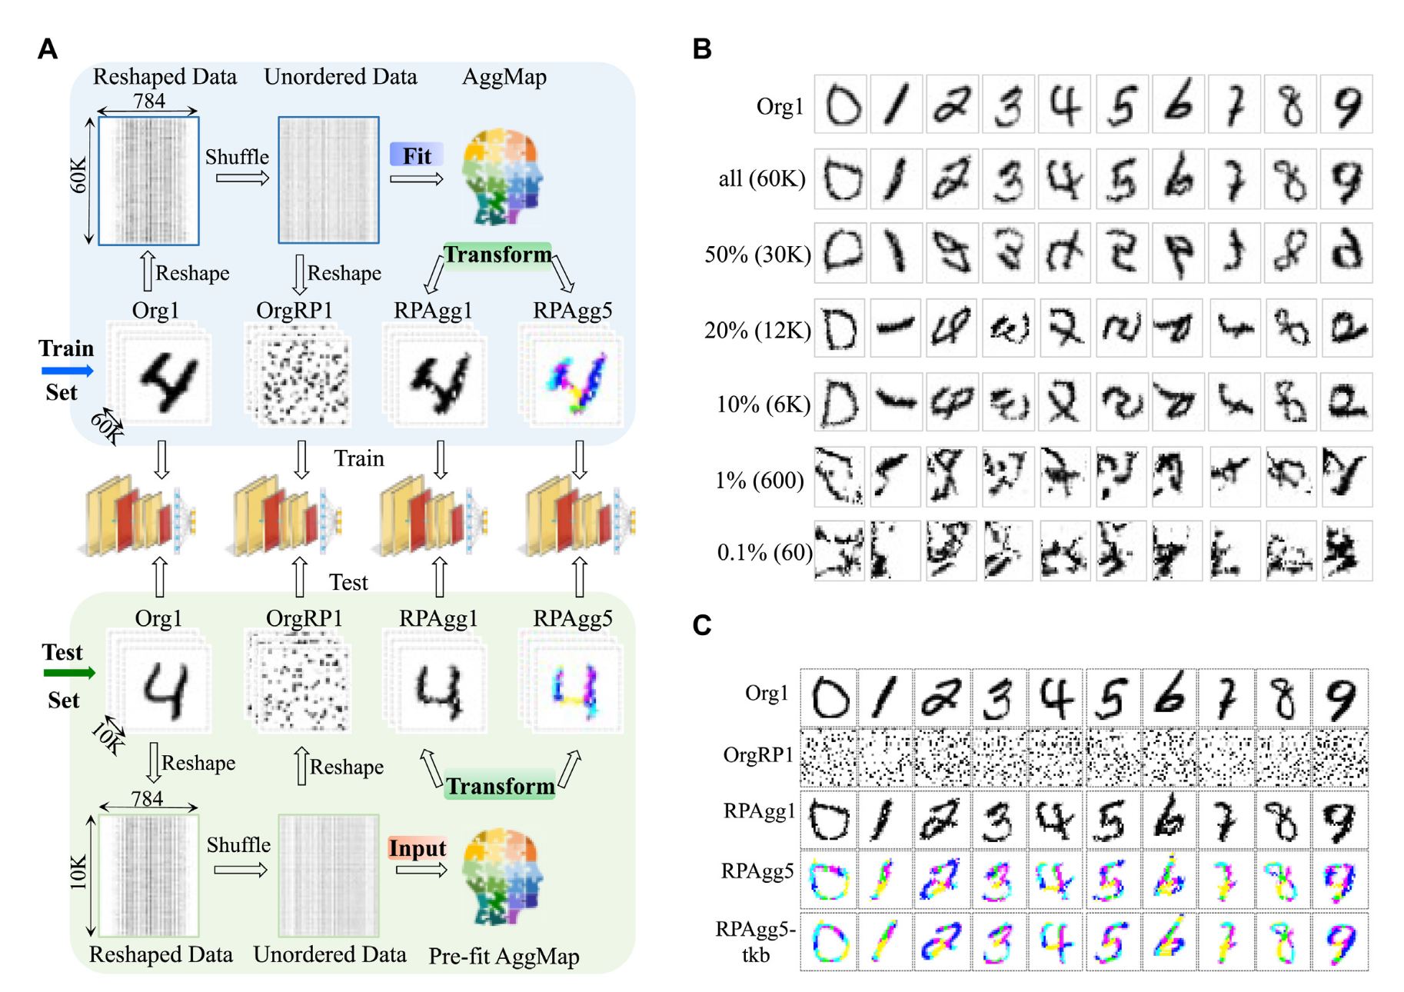
Results
Good feature restructuring capability of AggMap

Slide 8
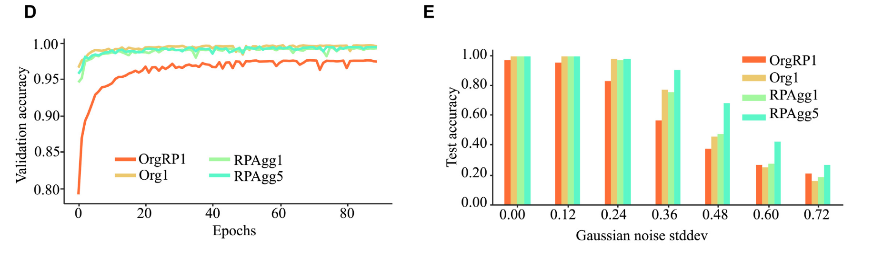
Results
Good feature restructuring capability of AggMap

Slide 9
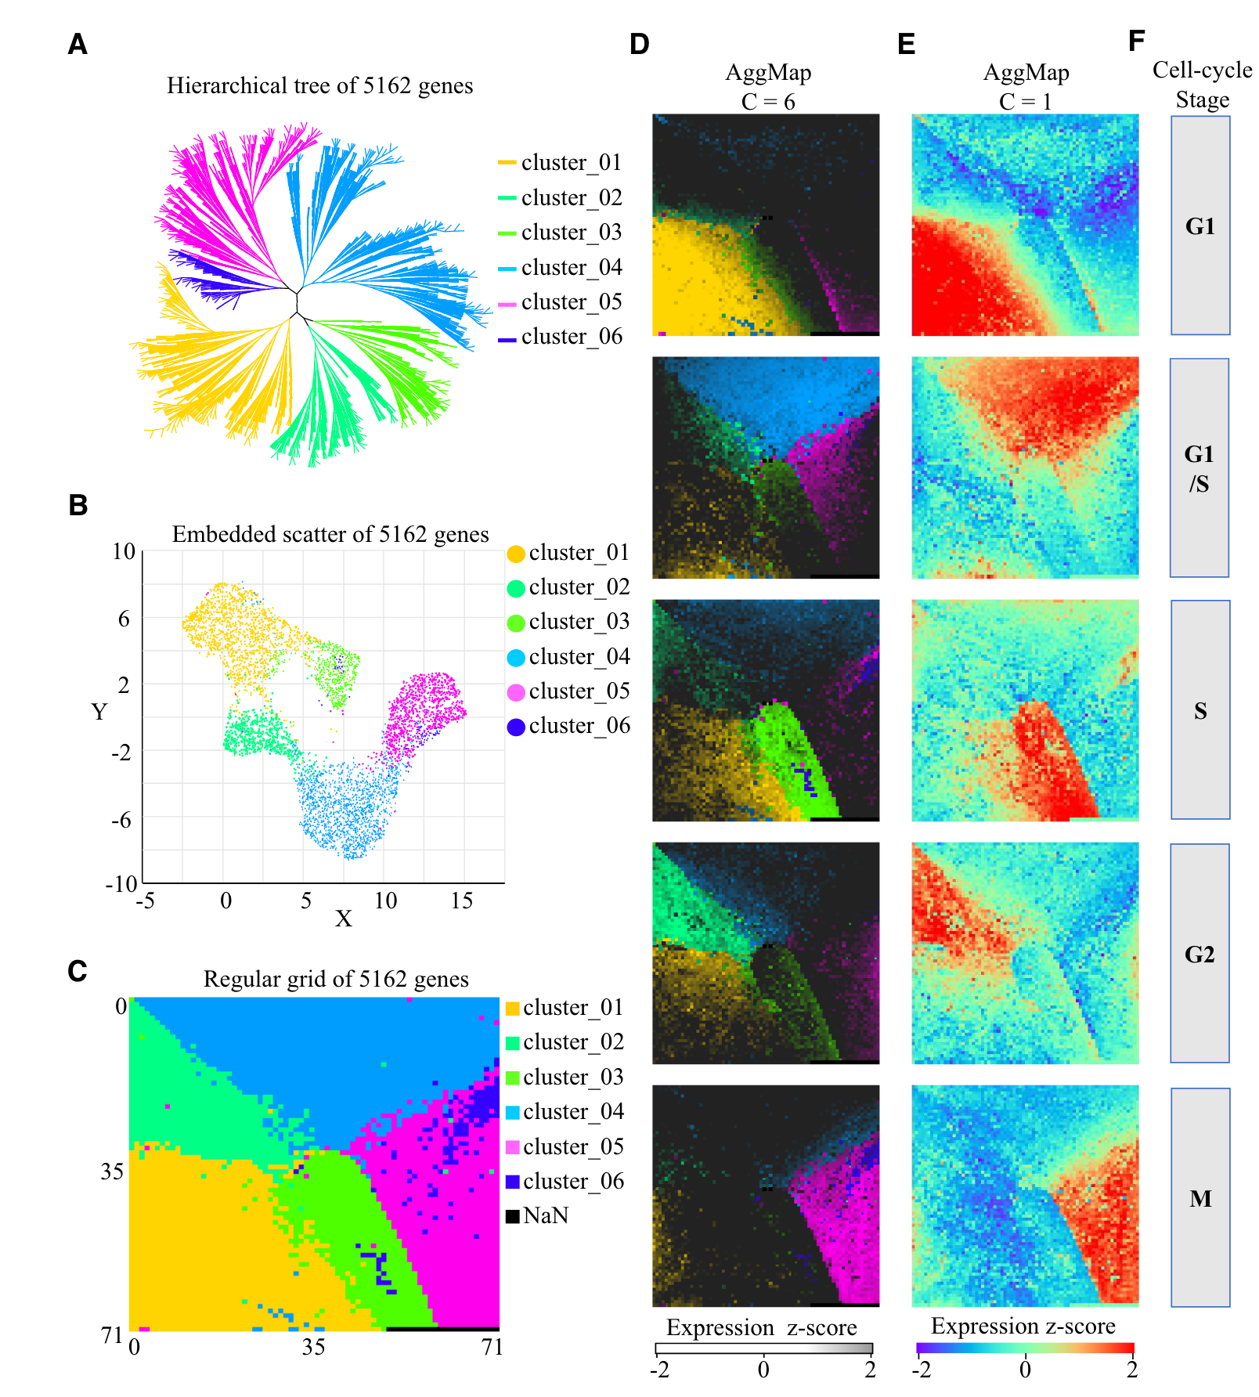
Results
The performance of AggMap on the restructuring of the cell-cycle dataset of CCTD-U

Slide 10
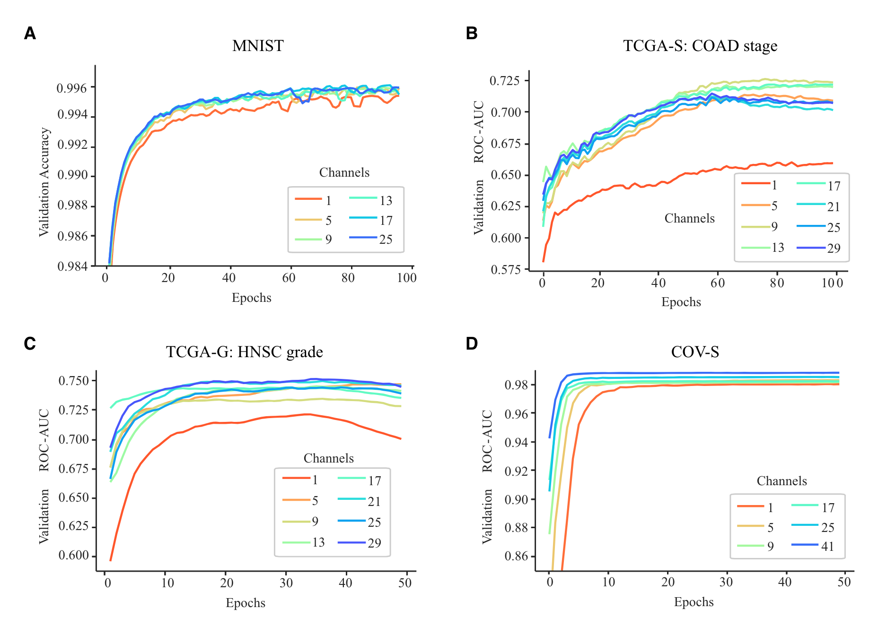
Results
The five-fold cross-validation average performance of AggMapNet using different number of channels on the four datasets.

Slide 11
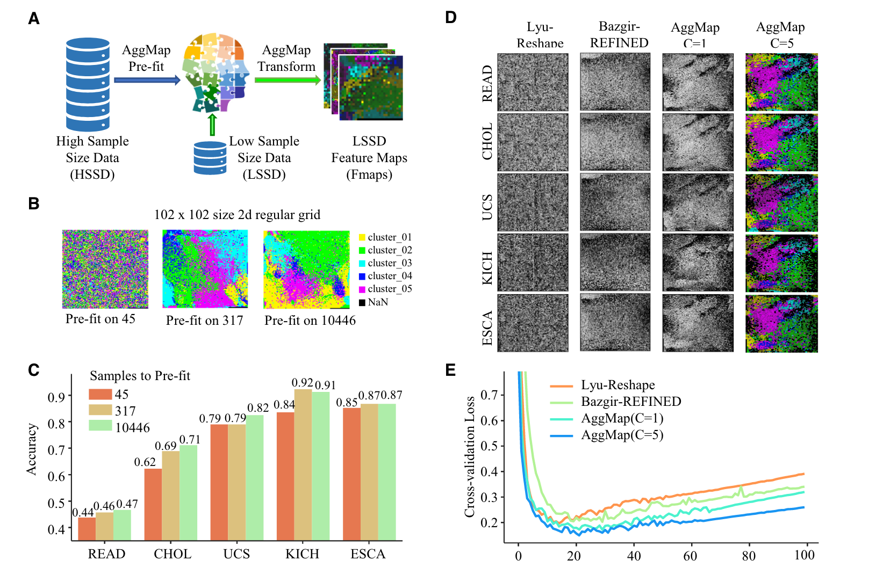
Results
The performances of AggMap and AggMapNet learning model on transcriptomic data TCGA-T, TCGA-S and TCGA-G

Slide 12
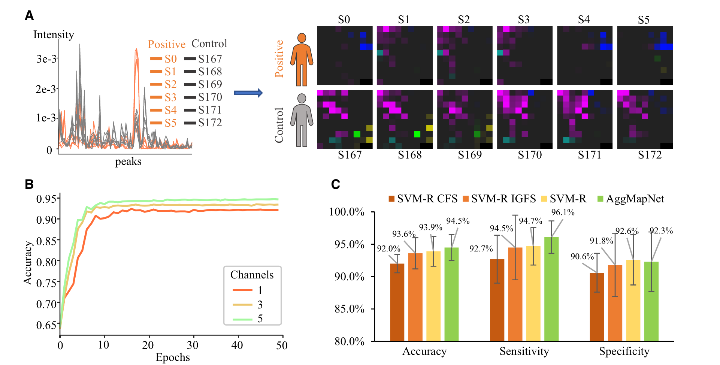
Results
AggMapNet in COVID-19 detections based on COV-D spectra dataset from the nasal swabs

Slide 13
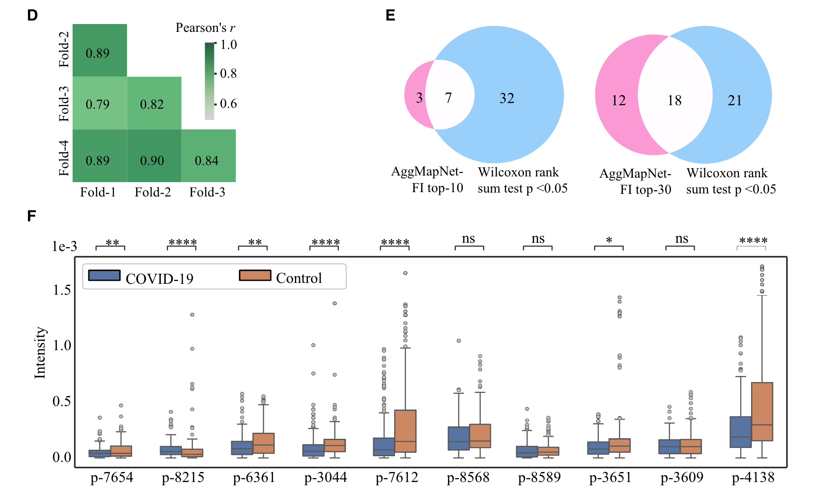
Results
AggMapNet in COVID-19 detections based on COV-D spectra dataset from the nasal swabs
Global FI importance

Slide 14
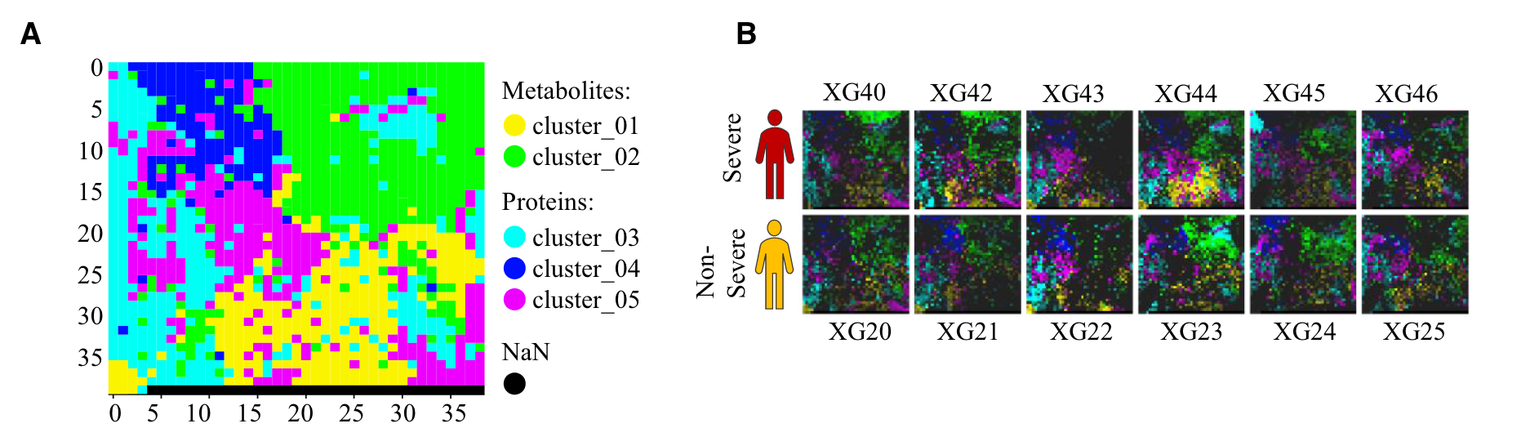
Results
The Multi-channel Fmaps and important FPs in distinguishing COVID-19 severe and non-severe cases by AggMapNet classification of the multiomics COV-S dataset.

Slide 15
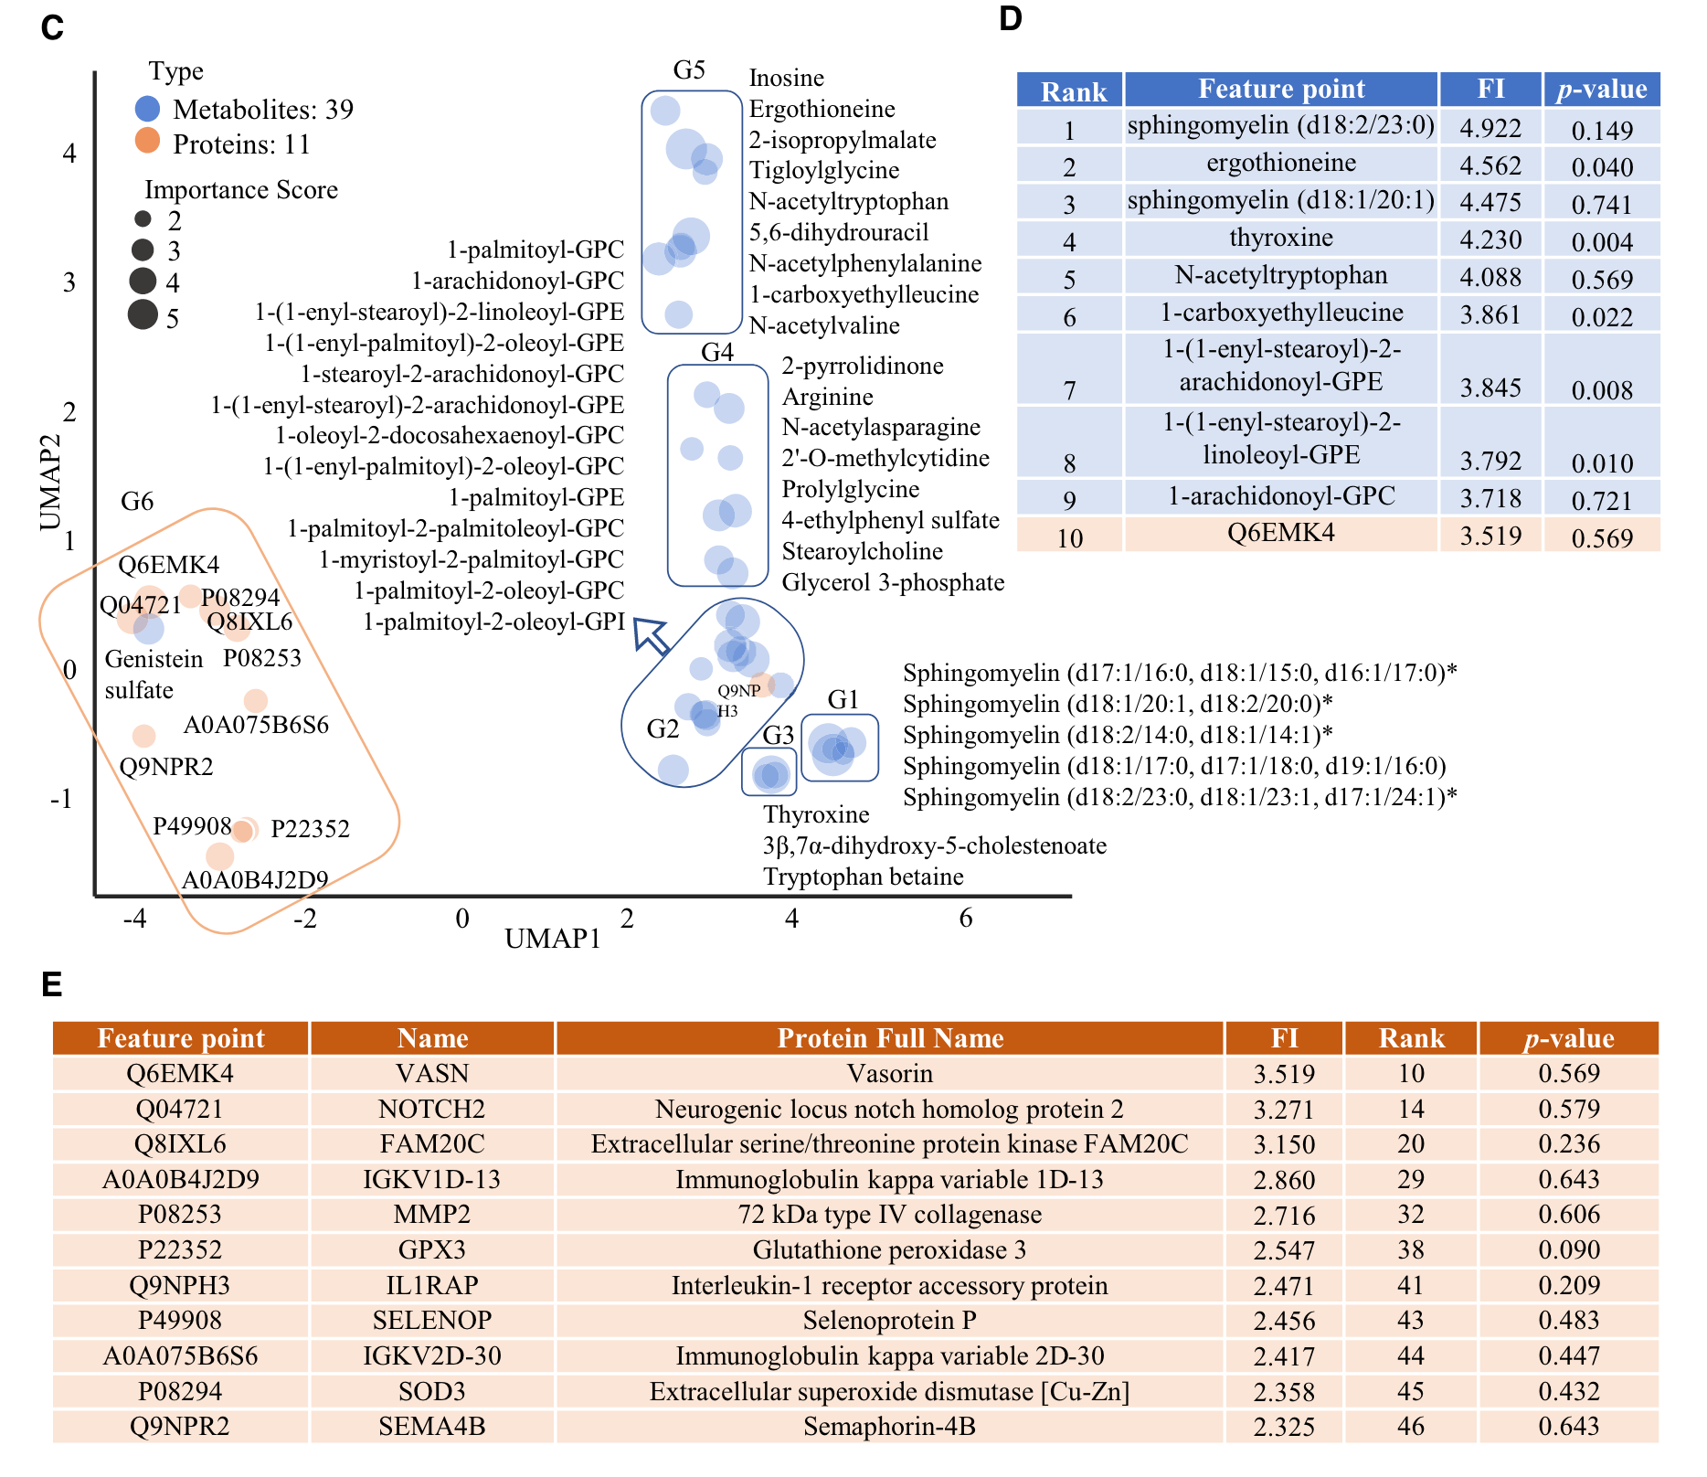
Results
The Multi-channel Fmaps and important FPs in distinguishing COVID-19 severe and non-severe cases by AggMapNet classification of the multiomics COV-S dataset.

